Slide 1
A note from the Chair
Dear Parents and Carers,
I wanted to take a moment to express our sincere gratitude for your unwavering support and generous contributions throughout this challenging year. Your dedication to our school community has been truly remarkable, especially considering the difficult financial circumstances many of us have faced.
Despite the hardships, your continued support has allowed our PTA to provide valuable resources, organise memorable events, and support various initiatives that have enhanced the educational experience for our children. Your donations, both in terms of time and financial contributions, have made a significant difference. We will continue next years fundraising for much needed playground improvements and resources as our main focus.
As the school year comes to a close, I encourage you to take pride in the collective effort and accomplishments we have achieved together. Our unity and resilience have been exemplified through your continued support.
Thank you once again for your unwavering commitment to our school community. We wish you a well-deserved summer break filled with relaxation, joy, and cherished moments with your loved ones.
With heartfelt gratitude,
Katrina Kelly
Why do we have a Friends of Committee?
The Friends of Rivington Foundation School is a registered charity whose aim is to raise money in a fun and sociable way, to provide the school with extra funding.
This is then spent on equipment and resources to enhance your child’s educational experience and the school’s facilities.
Event Information
Full information and event details will be released closer to each event.
Our aim will be to release information in the headteachers newsletter, text messages and on the Mums and dads page on Facebook.
Contact Us
If you are interested in joining our volunteer list, have any fundraising ideas or questions please see one of the committee members:
Katrina Kelly - Chair person
Joanna Clayton Stead – Vice Chair
Nicola King – Secretary
Claire Stubbs & Alexandra Macdonald – Treasurer
Rebecca Cliffe – School lead
Rachel Husband – Committee member
Sarah Shepherd – Committee member
Emma Bramwell – Committee member
Christine Brooke – Committee member
Jennie Bearman – Committee member
Caroline Griffin – Committee member
Nicola Mallon – Committee member
pta.rivington@gmail.com
AGM
Our AGM will be held in September, the exact date will be published at the start of the new school year. If you would like to volunteer or want to join the committee please get in touch.
pta.rivington@gmail.com

Slide 2
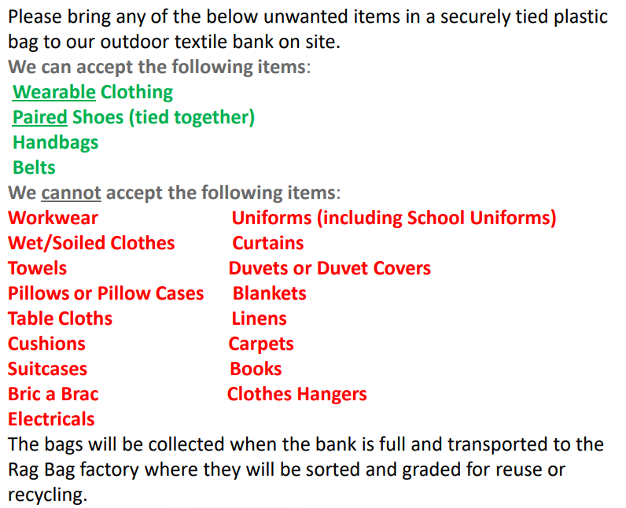
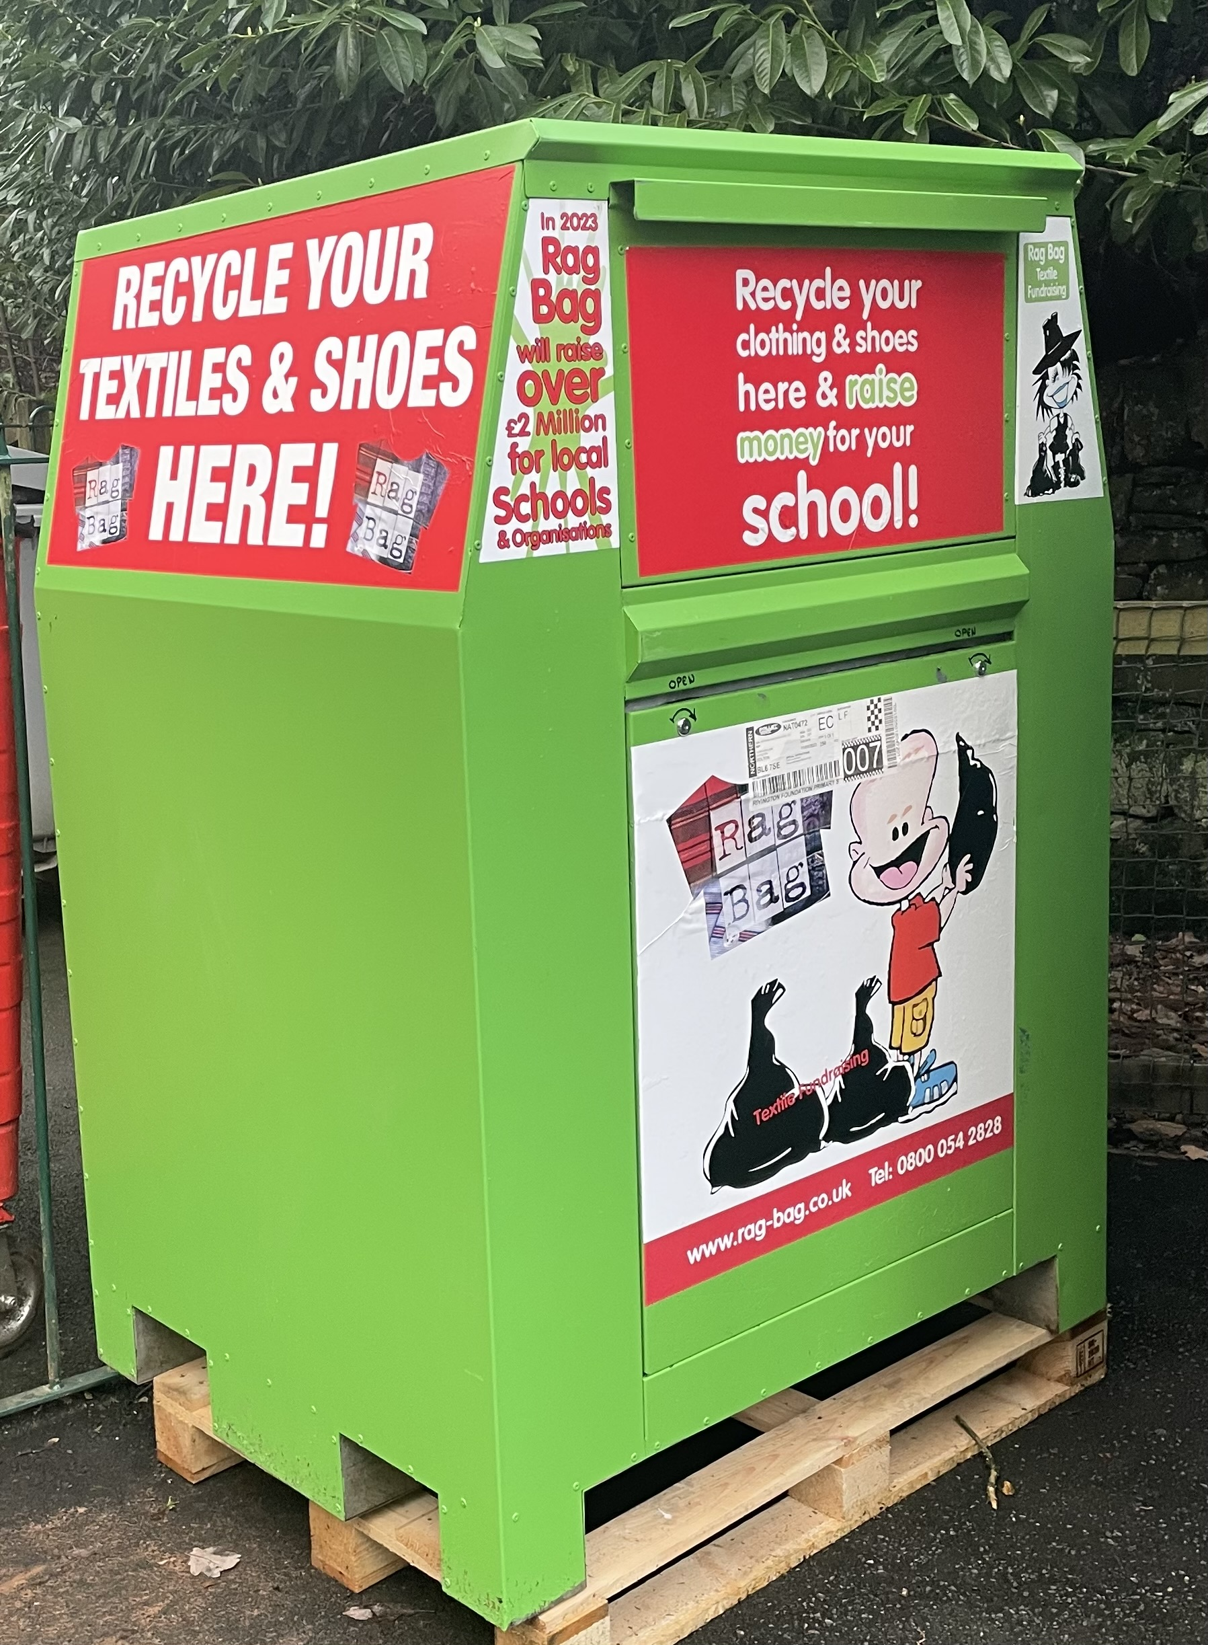
Easyfundraising
Please support Friends of Rivington Foundation Primary School on easyfundraising this year, you can raise FREE donations when you shop online with over 7,000 brands. It's simple and only takes 2 minutes to sign up! This will make a BIG difference to us. We have currently raised
over £1,000 with only 39 supporters
imagine what we could raise if
everybody joined!
You can raise donations in one easy click with the FREE #easyfundraising Donation Reminder. It finds donations when you shop as normal with over 7,000 brands.
Fundraising can continue throughout the summer holidays
Recycle, Recycle, Recycle!
The textile bank will remain in school for you to recycle any unwanted clothes and shoes. We have filled it 3 times already raising £168, keep it going!
Scan the QR code to join or download the app from the APP store or Google play

Slide 3
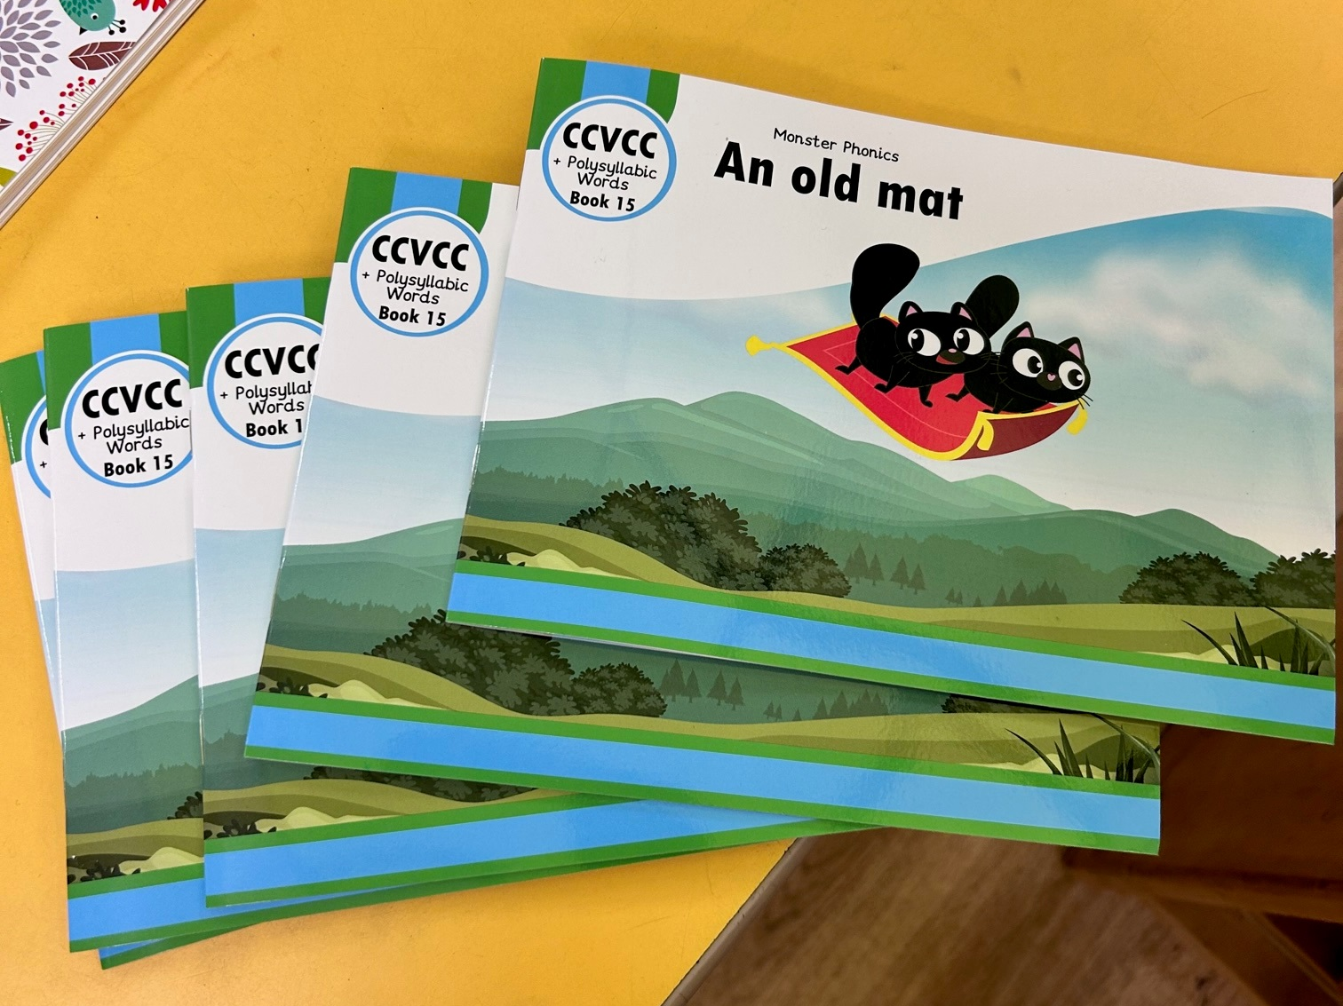
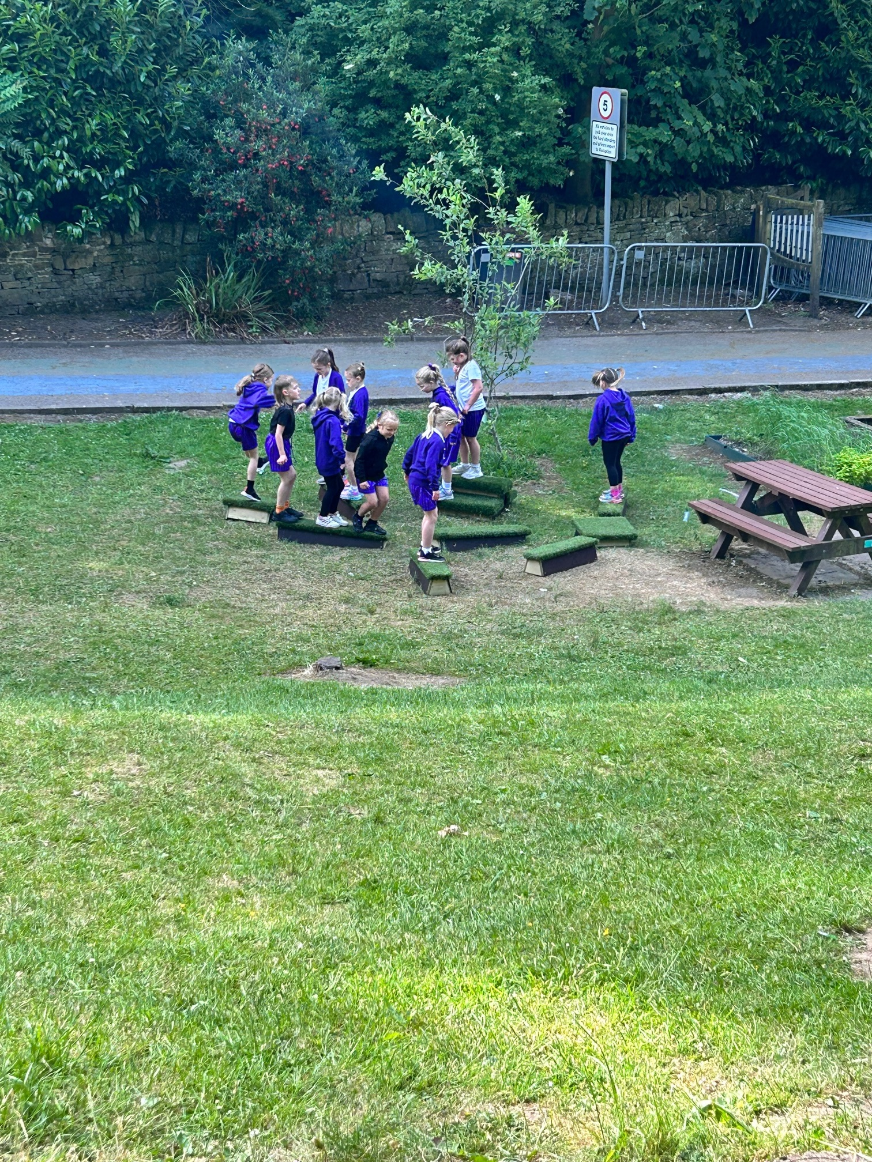
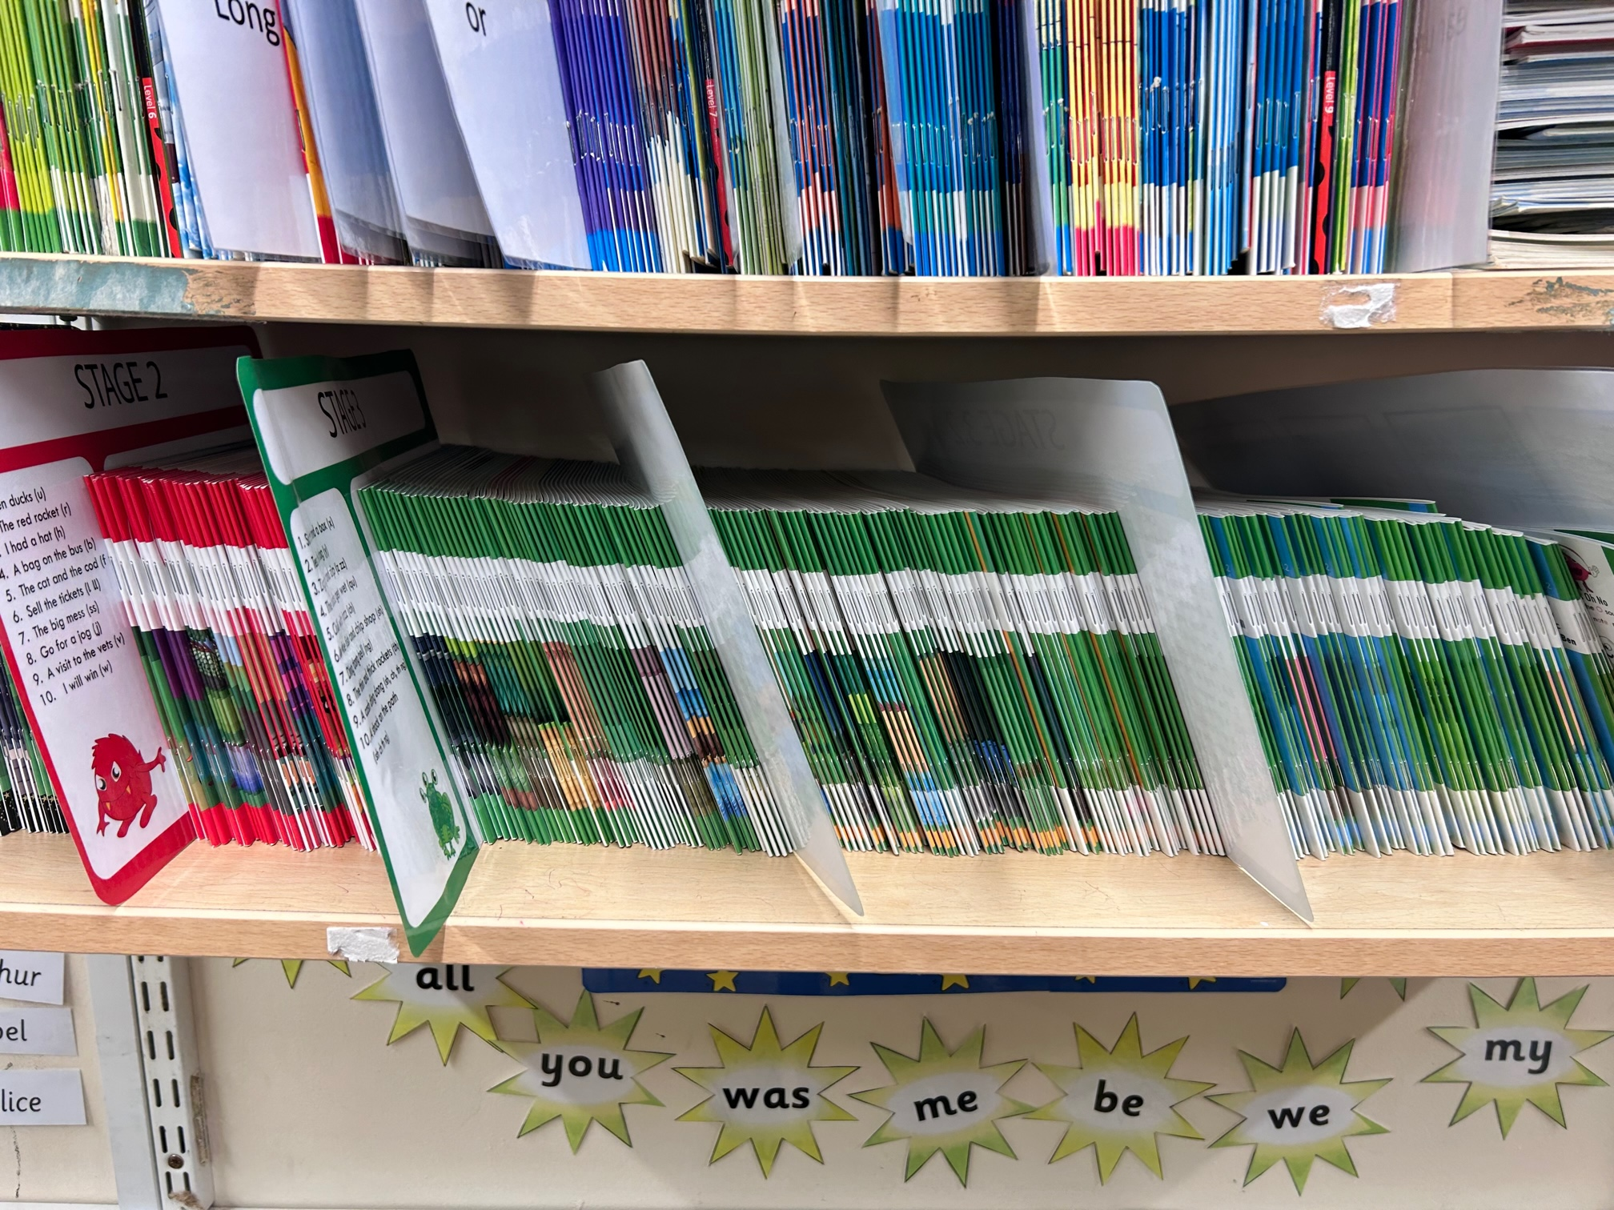
What have the Friends of Committee funded?
Balance beams for the playground
Breakfast with Santa gifts
Signage for the playground
Subsidised whole school pantomime trip
CUSP teaching programme for Geography and History
Teacher training for new Monster Phonics Programme
Monster Phonics Books
Snacks & drinks for Year 6 leavers party
Christmas Fair
£3000
Mothers Day Shop £150
Wreath making £290
Clothes Bank £168*
Easter Bingo
£1000
Ice Pops
£231
Rivington Spring Fair
£206
Kings Coronation Tea Towels £318
Summer Fair £1800
UV Disco £280
Asda Green Token Scheme
£300*
EasyFundraising £542.92* (further £473.82 pending)
* Paid directly into school bank account

