Slide 1
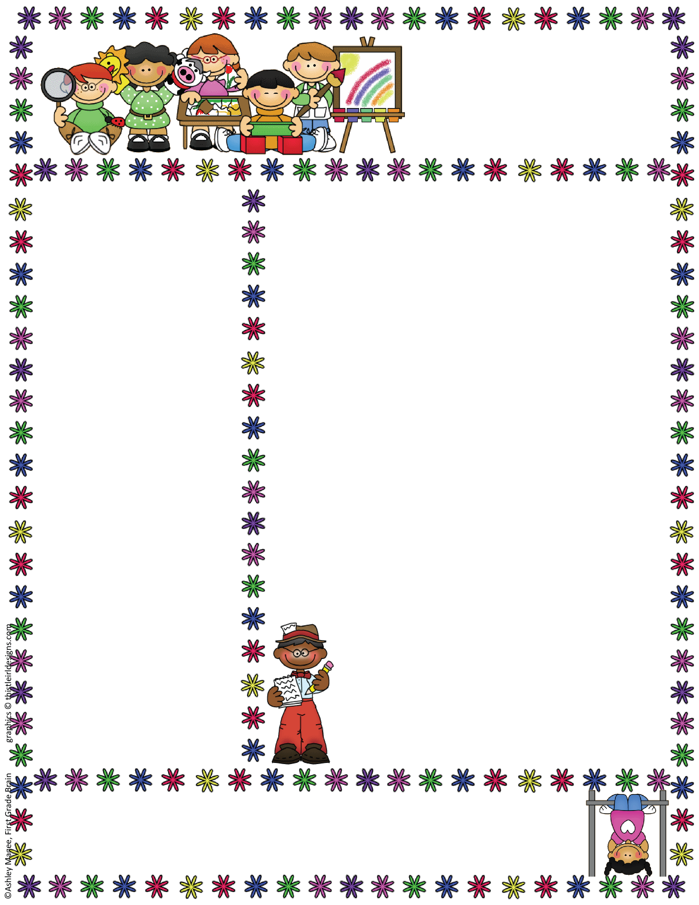
Anglezarke Class
EYFS Newsletter
October, 2019
Things to Remember
Names in clothes
Please remember to name all items of clothing so we can return them safely to you ☺
Topic Questionnaires
If you have not already done so please could you return your topic questionnaire – this will help us plan. ☺
Magic Moments
We love to see pictures and hear about all the lovely things you have been up to in the holidays so please send in any “Magic Moments” for your child to share in class.
Wow Tickets
We love celebrating your child’s learning at home – if you run out of these please put a note in your child’s planner / diary and we will send some home. ☺
Welcome to Autumn Term 2!
I can’t believe we have completed half a term already! The children have all settled into school really well and have gained so much independence already, hanging their coat up, finding their name card etc. To further promote independence and to ease congestion in our small room, please could we ask that parents now let their children come in by themselves and say goodbye at the door. There is always a staff member on the door should you need to speak to one of us. Thank you ☺
Class News
We have an exciting and busy half term ahead of us as we lead up to Christmas. There will be lots of events coming up so please keep an eye on the school newsletter for details! Reception will join Year 1&2 for a Christmas production in December. Nursery children will take part in all the other events but we know from past experience that it is too much to expect the very little ones to sit through rehearsals and they much prefer to continue their Christmas activities in the classroom. This has worked well for the last few years and don’t forget they have many years of Christmas plays to come! ☺
Topic Information
This term our topic will be “Colour my World.” We will start by exploring the “Elmer the patchwork elephant” story and investigating patterns. We will provide information in your home / school diaries each week. PTO for more information.
Class Teacher: Mrs. Amanda Davies 01204696951
Rivington Foundation Primary School www.rivingtonprimaryschool.co.uk
Rivington, Lancashire, BL67SE

Slide 2
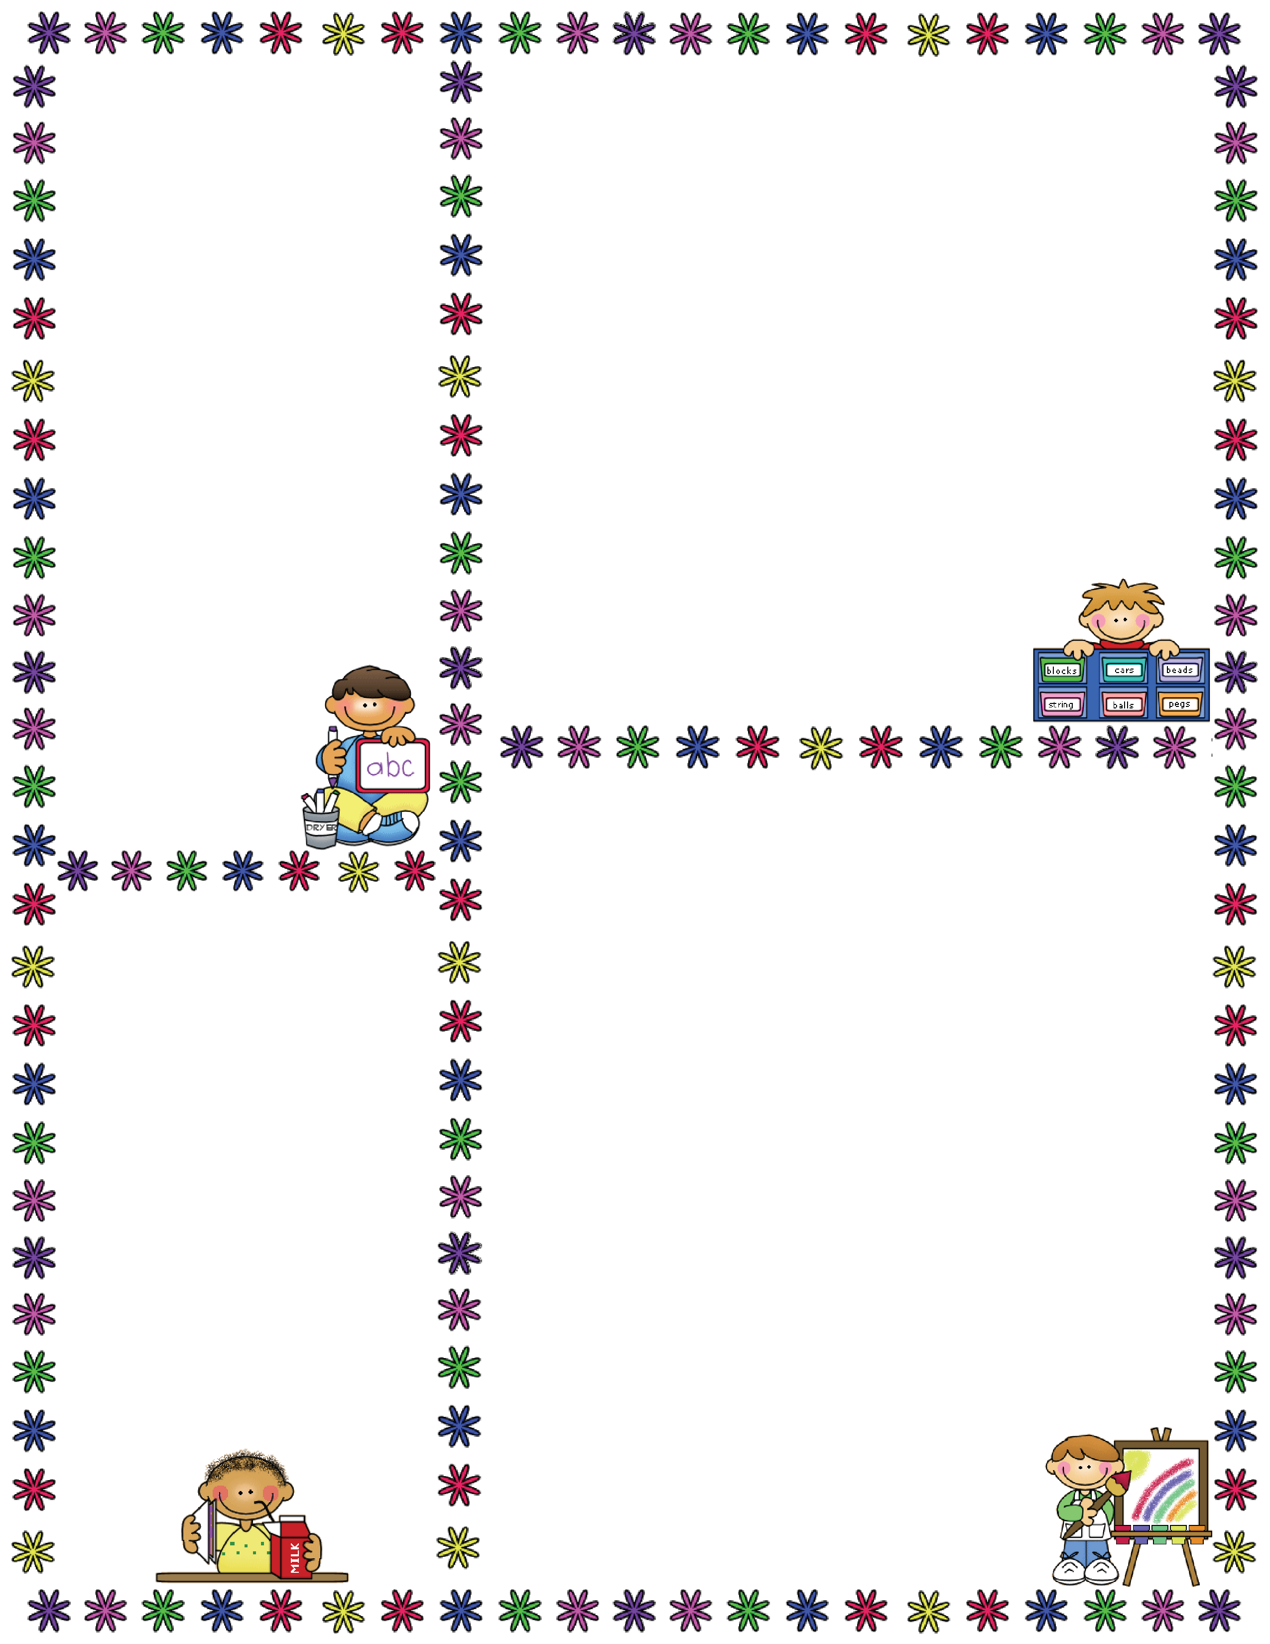
Forest School
It is a great time of year to get outdoors and experience the changes that are happening in our environment. We are hoping to start our forest school sessions this half term. (Depending on the weather.) We will send full details out soon and you will also need to fill in some permission slips. We will advise you via the planners / diaries when this will be
happening so you can
send your child in with appropriate clothing. As you will understand, we need a greater number of adults accompanying us to the forest for safety reasons and these sessions can not go ahead without the right
ratio of adults to children
so if anyone can help
please let us know.
Thank you, it is much
appreciated!
Some information about the EYFS…
EYFS = Early Years Foundation Stage
This is the stage between birth and age 5.
The EYFS is split in to 3 Prime areas…
Communication and Language (C&L)
Physical Development (PD)
Personal and Social Development (PSED)
…and 4 Specific areas…
Literacy (L)
Mathematics (M)
Understanding the World UW)
Expressive Arts & Design (EAD)
“Colour My World” Topic ideas…
In the EYFS we follow the children’s interests and needs so it is not always possible to plan too far in advance! However, some ideas for this topic are:
C&L: Use of colour vocabulary, colour names, darker, lighter…
Talking about what makes us special & unique.
PD: Using scissors to make collages, using pencils to write Christmas lists. Using PE equipment such as balls & beanbags.
PSED: The importance of sharing (like the rainbow fish.)
Celebrating our uniqueness (like Elmer.)
Diwali – the Hindu festival of light.
The Christmas story.
L: Reading books about colour eg. The Rainbow fish, Elmer & Wilbur, The mixed up Chameleon, Picasso the tree frog, Brown bear, brown bear, mouse paint, plant a rainbow.
M: Patterns (link to Elmer.)
2D and 3D shapes (link to presents & decorations.)
Numbers to 25 – Advent, counting down to Christmas.
UW: Changes in the environment, Autumn, Winter, colours and patterns in the environment.
EAD: Experimenting with colour mixing.
Making collages and patterns.
Making Christmas cards.
Singing Christmas songs.
Who’s who…
There are three full time members of staff in our class;
Mrs Davies – Teacher
Mrs Orgill – Assistant
Mrs Shaw – Assistant
Please do not hesitate to speak to any of us about any concerns or questions!
☺

