Slide 1
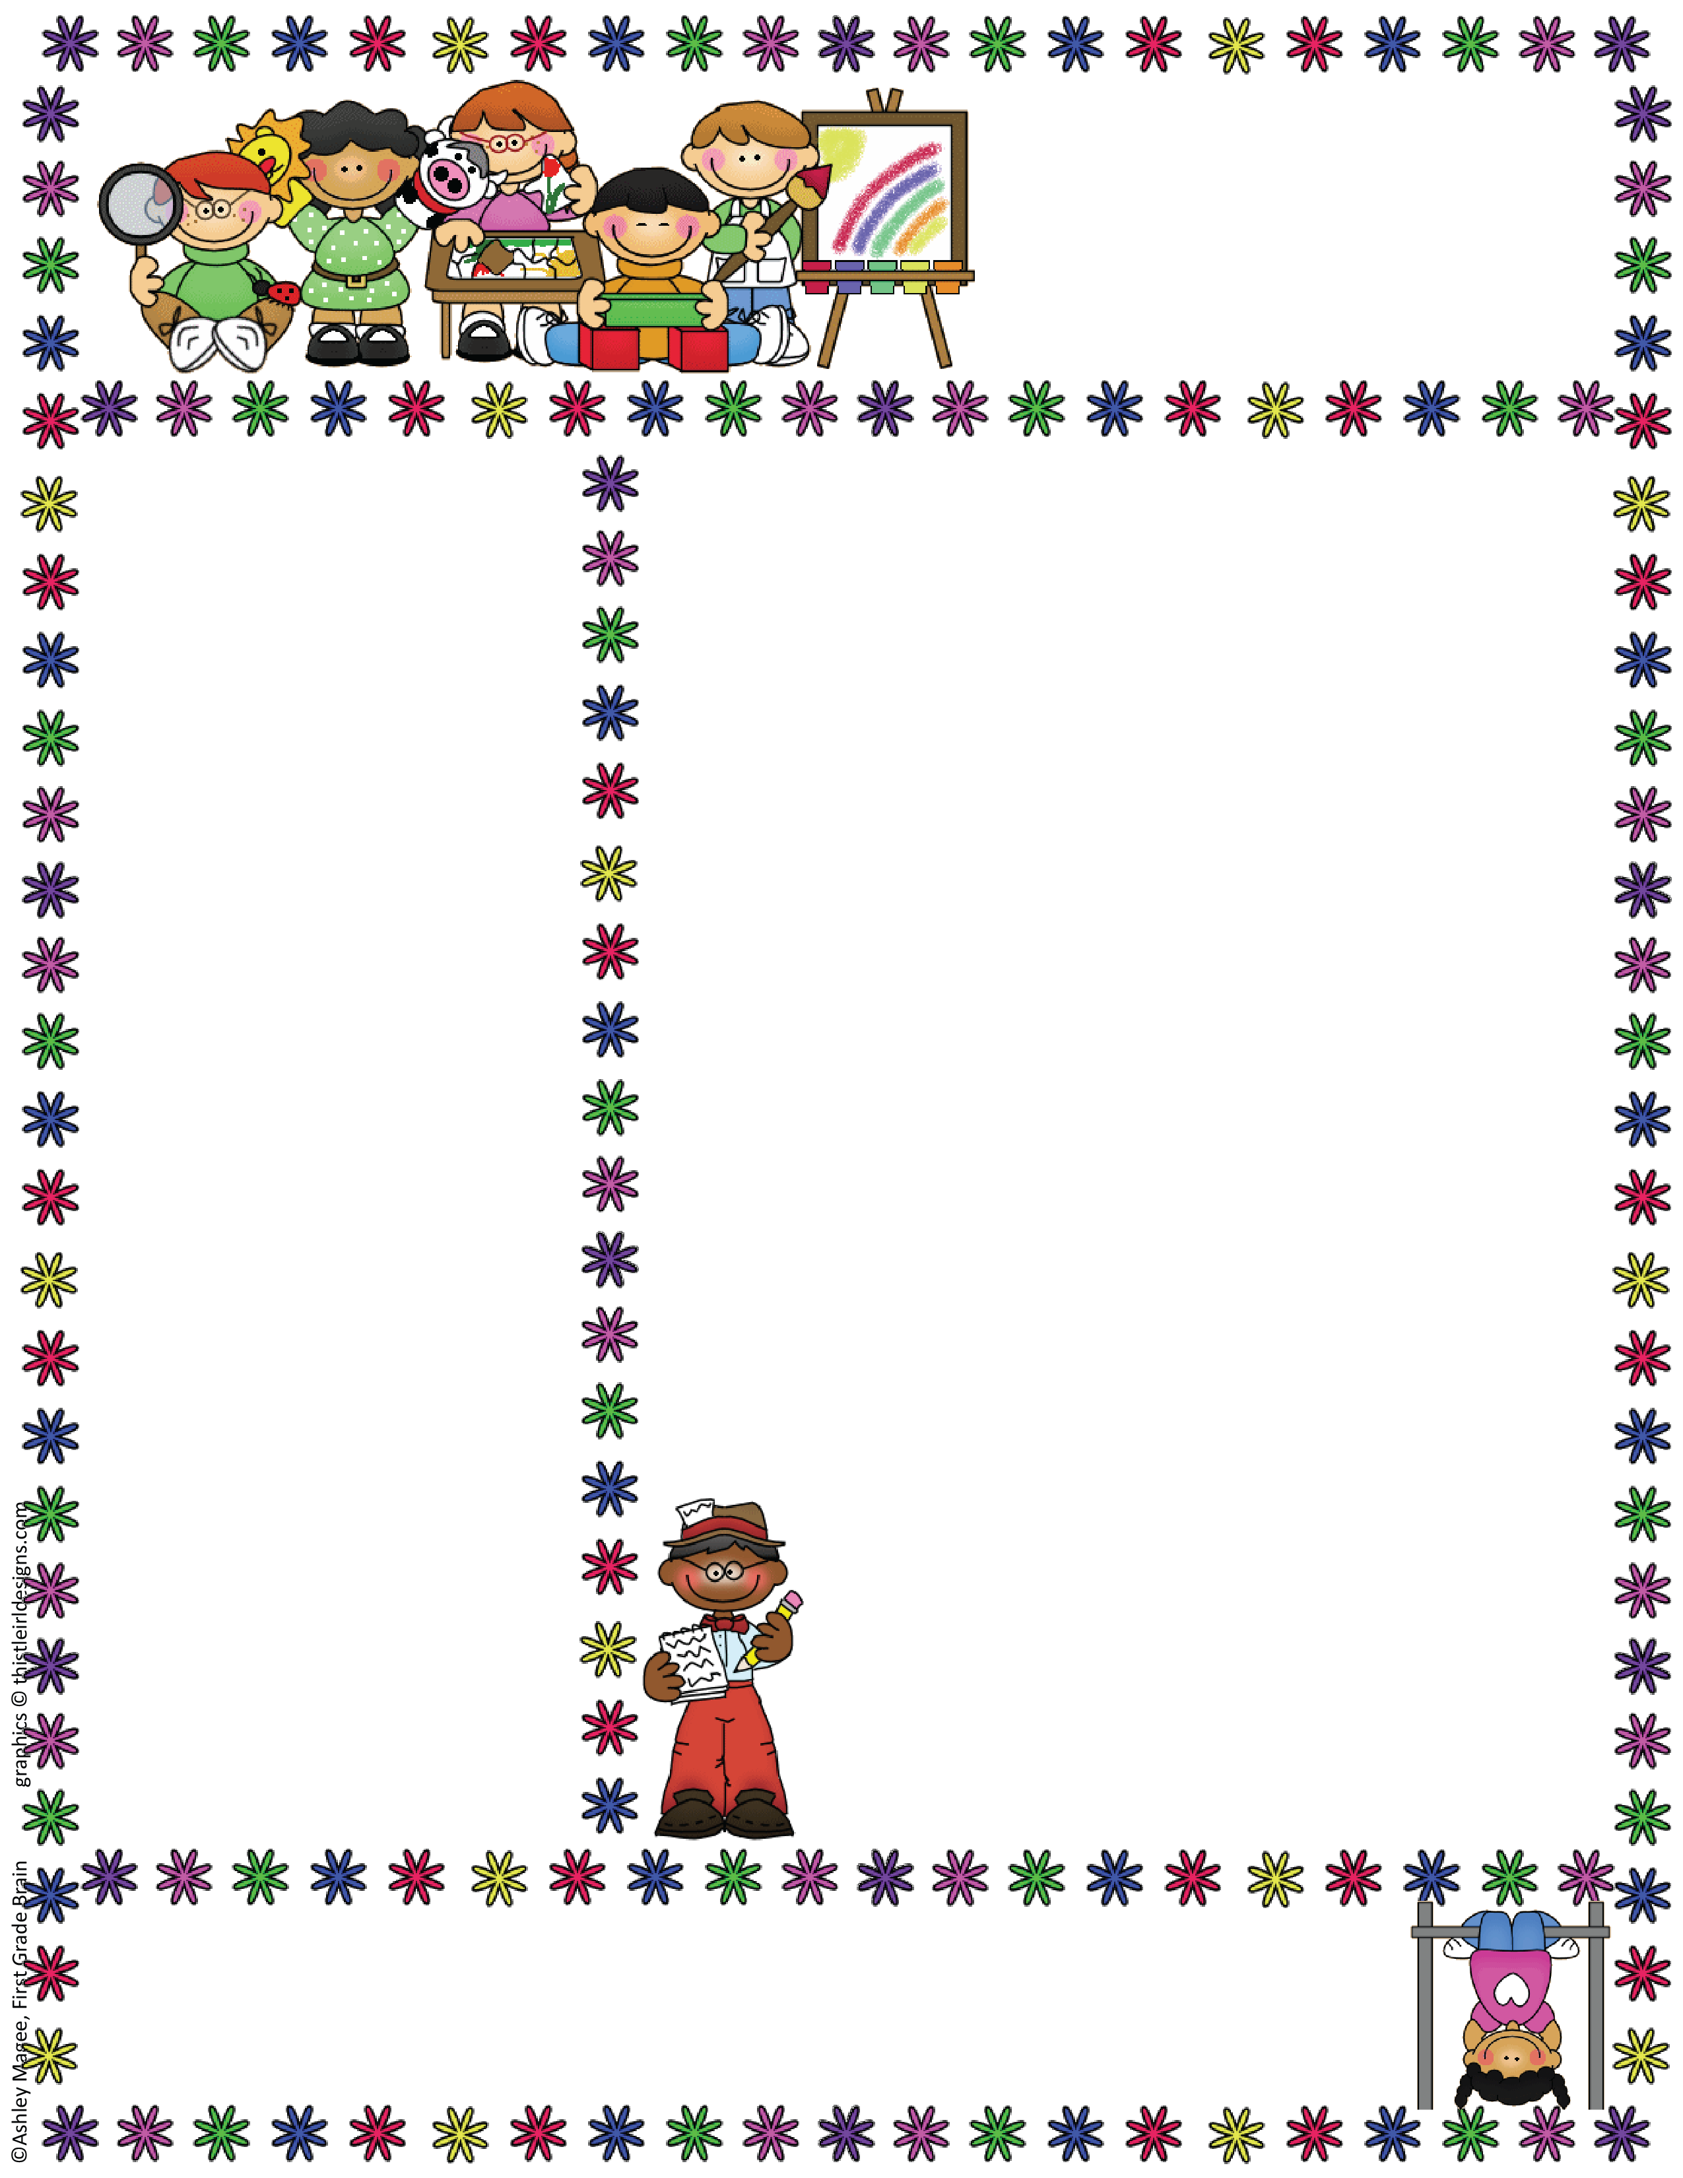
Anglezarke Class
EYFS Newsletter
September 2019
Things to Remember
PE is Tuesday & Thursday – Please ensure that all YR children have kits in school and any YN children in school on a Tuesday have pumps in a drawstring bag.
Please remember to name all items of clothing so we can return them safely to you ☺
If you have not already done so please could you return your topic questionnaire – this will help us plan. ☺
Please could any Report files that have not been returned from last year be returned ASAP – Thank you ☺
Could “All about me” booklets please be completed & returned for all New YN &YR children.
Please could all Reception parents read and sign the Home / School Agreement, E-Safety form and Generic permission form found at the front of your planners. Nursery will receive these as letters.
Welcome to School!
Welcome to all our new Reception and Nursery children and families! Welcome back to everyone who was with us last year, we hope you enjoyed your Summer holidays!
Learning Information
We will spend the first few weeks settling in, making new friends and learning how to use all our classroom areas and resources. The staff will also be completing our “Baseline Assessments” which will help us plan for each child’s next steps. This involves the staff observing the children as they play and also working with them on play based activities. If your child attended another setting prior to starting at Rivington and were given a report or Learning Journey we would love to take a look at this please as this will help us understand their current stage of development. ☺
Topic Information
This term our topic will be all about Houses and homes. After our assessments are complete we will start by exploring the “Three Little Pigs” story and investigating materials. We will provide information in your home / school diaries each week. PTO for more information.
Class Teacher: Mrs. Amanda Davies 01204696951
Rivington Foundation Primary School www.rivingtonprimaryschool.uk
Rivington, Lancashire, BL67SE

Slide 2
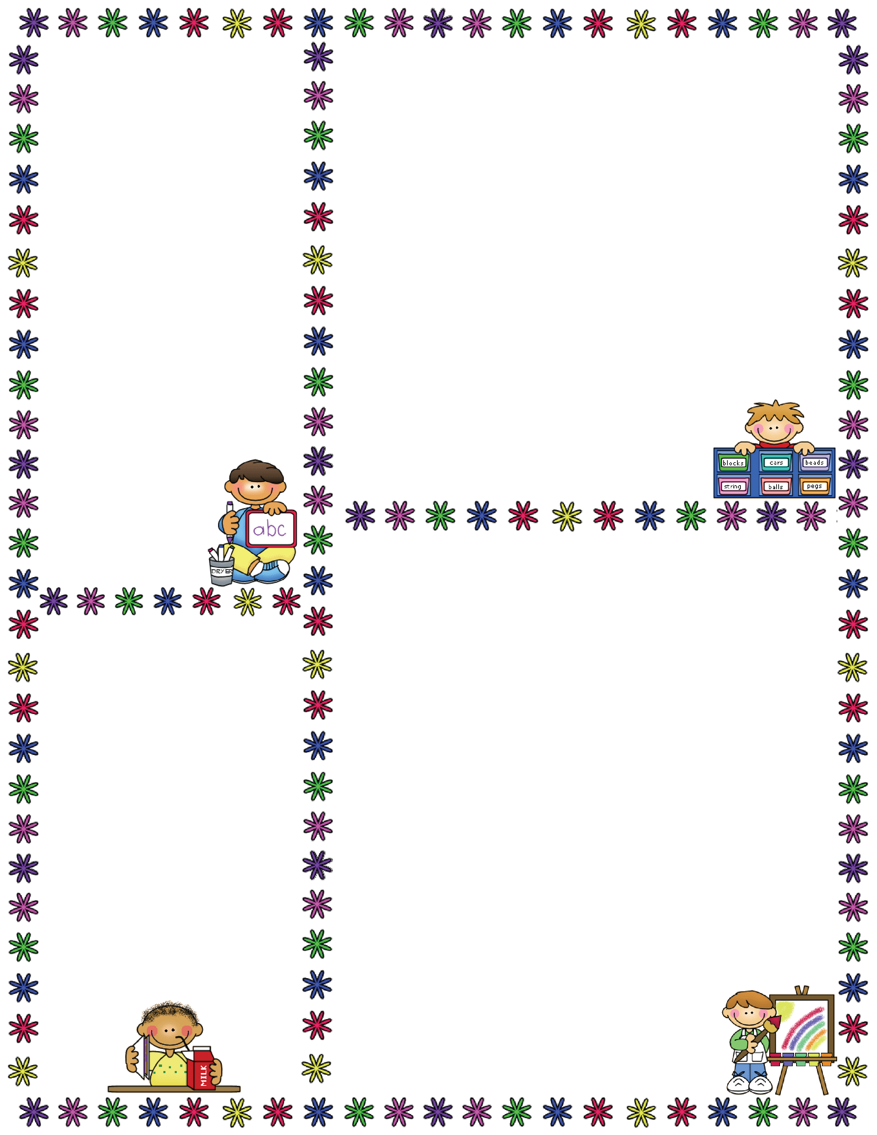
Reception Reading Books
We know how exciting it is when your child receives their first reading book! This will happen later on this half term.
Some information about the EYFS…
EYFS = Early Years Foundation Stage
This is the stage between birth and age 5.
The EYFS is split in to 3 Prime areas…
Communication and Language (C&L)
Physical Development (PD)
Personal and Social Development (PSED)
…and 4 Specific areas…
Literacy (L)
Mathematics (M)
Understanding the World UW)
Expressive Arts & Design (EAD)
Discussion Books
Nursery children will be able to choose a library book or story sack each week, they are not expected to be able to read these but are for sharing with an
adult at home. ☺
Book Bags
Please only send the flat school bags as we don’t have room for rucksacks.
We have some
flat purple Bags
for sale for £3
For Nursery.
Houses and Homes Topic ideas…
In the EYFS we follow the children’s interests and needs so it is not always possible to plan too far in advance! However, some ideas for this topic are:
C&L: Talking about our homes and our families, roleplaying the three little pigs.
PD: How to stay safe at home, dangers in the home.
PSED: Who lives in our homes, exploring family and relationships.
L: Listening to and discussing stories such as The three little pigs, The house that Jack built, The old lady who lived in a shoe…
M: Sorting objects, which room do they belong in? Looking at shapes on buildings and homes. Door numbers, ordering numbered houses.
UW: Learning about different types of homes
in our locality, similarities and differences, looking at homes around the world.
EAD: Building and designing
Houses for the three little pigs –
Strong enough to endure a wolf!
Who’s who…
There are three full time members of staff in our class;
Mrs Davies – Teacher
Mrs Orgill – Assistant
Mrs Shaw – Assistant
We all like to think we are very friendly and approachable ☺ so please don’t hesitate to speak to any of us about any concerns or questions!
☺

