Slide 1
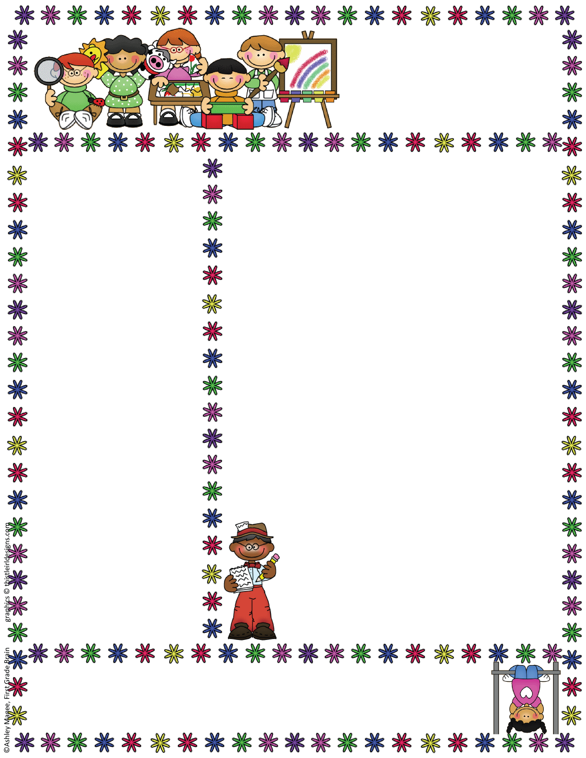
Anglezarke Class
EYFS Newsletter
October, 2018
Things to Remember
Wellies
We still have a few children who don’t have any wellies in school – please send some in so they can get messy outside!
Names in clothes
Please remember to name all items of clothing so we can return them safely to you ☺
Topic Questionnaires
If you have not already done so please could you return your topic questionnaire – this will help us plan. ☺
Magic Moments
We love to see pictures and hear about all the lovely things you have been up to in the holidays so please send in any “Magic Moments” for your child to share in class.
Wow Tickets
We love celebrating your child’s learning at home – if you run out of these please put a note in your child’s planner / diary and we will send some home. ☺
Welcome to Autumn Term 2!
The children have all settled into school really well and have gained so much independence already! We have an exciting and busy half term ahead of us as we lead up to Christmas. There will be lots of events coming up so please keep an eye on the school newsletter for details! Reception will join Year 1&2 for a Christmas production in December. Nursery children will take part in all the other events but we know from past experience that it is too much to expect the very little ones to sit through rehearsals and they much prefer to continue their Christmas activities in the classroom. This worked well last year and don’t forget they have many years of Christmas plays to come! ☺
Class News
Unfortunately you will have noticed that Mrs. Grimal has been absent from school for the past few weeks. We are very happy however to have Mrs. Hitchin covering full time until her return. Mrs Hitchin knows the children vey well due to her other roles in school such as TA and lunchtime supervisor.
Topic Information
This term our topic will be “Toys” We will start by exploring the “The Toys Party” story. We will provide information in your home / school diaries each week. PTO for more information.
Class Teacher: Mrs. Amanda Davies 01204696951
Rivington Foundation Primary School www.rivington.lancs.sch.uk
Rivington, Lancashire, BL67SE

Slide 2
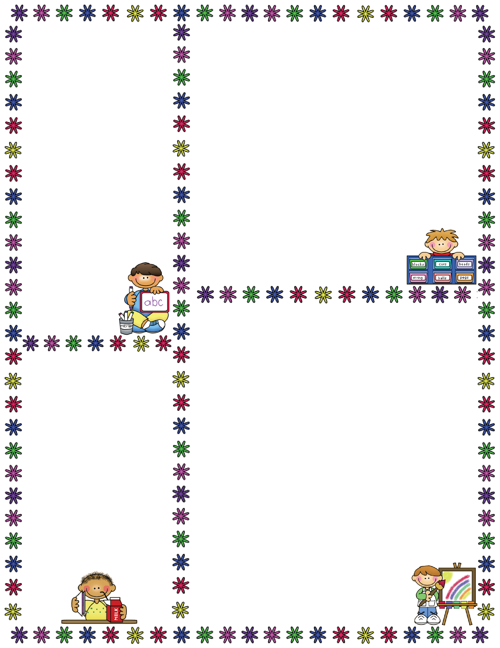
Forest School
It is a great time of year to get outdoors and experience the changes that are happening in our environment. We are hoping to start our forest school sessions this half term. (Depending on the weather.) We will send full details out soon and you will also need to fill in some permission slips. We will advise you via the planners / diaries when this will be
happening so you can
send your child in with appropriate clothing. As you will understand, we need a greater number of adults accompanying us to the forest for safety reasons and these sessions can not go ahead without the right
ratio of adults to children
so if anyone can help
please let us know.
Thank you, it is much
appreciated!
Some information about the EYFS…
EYFS = Early Years Foundation Stage
This is the stage between birth and age 5.
The EYFS is split in to 3 Prime areas…
Communication and Language (C&L)
Physical Development (PD)
Personal and Social Development (PSED)
…and 4 Specific areas…
Literacy (L)
Mathematics (M)
Understanding the World UW)
Expressive Arts & Design (EAD)
“Toys” Topic ideas…
In the EYFS we follow the children’s interests and needs so it is not always possible to plan too far in advance! However, some ideas for this topic are:
C&L: Showing and talking about favourite toys. Giving instructions – operating toys.
PD: Using scissors to make collages, using pencils to write Christmas lists. Using PE equipment such as balls & beanbags.
PSED: The Christmas story. The importance of sharing, kindness to others.
L: Reading books about toys eg. The toys party, Harry & the robots, Ten in the bed, The lost teddy, Dogger, A-Z of toys, How does it work?
M: Numbers, partitioning numbers, adding more, taking away, 2D shapes and patterns.
UW: Changes in our environment.
Christmas around the world.
Remote control toys, Beebots.
EAD: Making Christmas cards.
Singing Christmas songs.
Who’s who…
There are three full time members of staff in our class;
Mrs Davies – Teacher
Mrs Grimal – Assistant (Covered by Mrs Hitchin until further notice.)
Mrs Orgill – Assistant
Please do not hesitate to speak to any of us about any concerns or questions!
☺

